Slide 1
E-COMMERCE SALES ANALYTICS DASHBOARD
Final Project Review | Department of CSE | KLH UNIVERSITY
TEAM MEMBERS
2420030789 – MILAN JAIN
2420030768 – NIKHIL REDDY
2420030039 – T VARUN
Guide: Dr.N.Sunanda, ASSOCIATE PROFESSOR | Academic Year: 2026–27
Notes:
Title slide. Replace all bracketed text. Use the full project title, list every team member with registration number, and name your guide. Insert the institution logo in the dashed box.

Slide 2
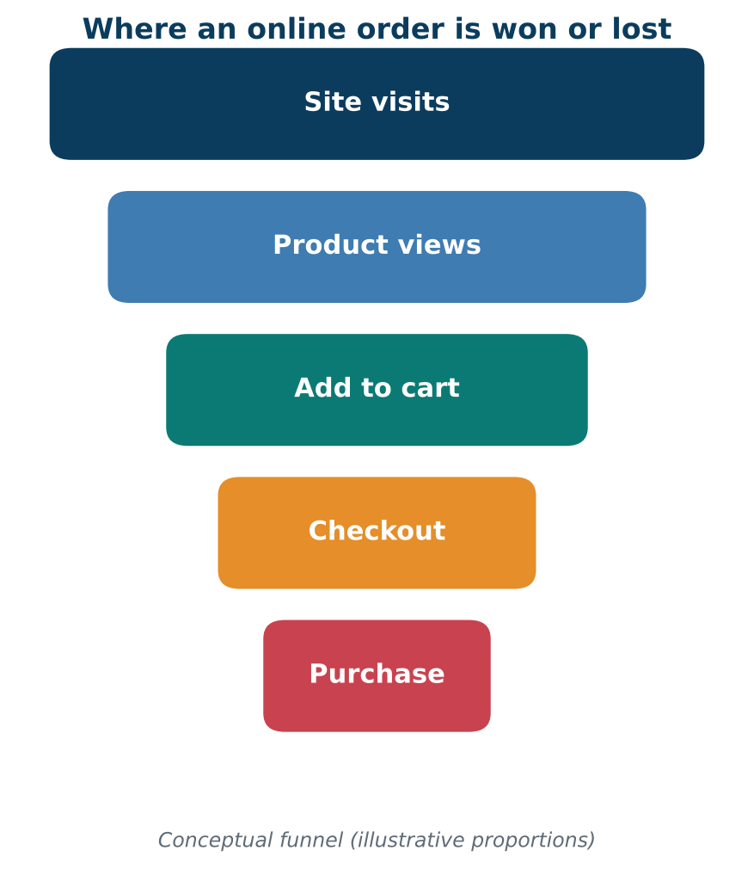



Introduction & Problem Statement
Background
Online retail produces huge volumes of order, customer and payment data. Turning it into clear, timely insight is now essential to stay competitive.
Problem Statement
Sales data sits in raw spreadsheets, so managers cannot quickly see revenue trends, top categories or which customers are likely to buy again.
Motivation / Need
Owners and analysts get faster decisions. Without it, stock-outs, wasted discounts and lost repeat customers go unnoticed.
Notes:
State the domain, the exact problem and why it matters. Keep it to about 2 minutes. Add one real-world statistic if you can, with a citation.

Slide 3


Objectives & Scope
Objectives
In Scope
1
Clean and consolidate 10,000+ order records into a reliable analytical dataset.
Data cleaning, EDA and sales KPI reporting
Repeat-purchase classification (3 models)
Dashboard views with category and region filters
2
Analyse revenue, category, region and seasonal trends using key sales KPIs.
3
Build and compare three ML models to predict repeat purchases (target ROC-AUC above 0.65).
Out of Scope
Real-time data streaming
Live payment or ERP integration
Recommendation engine and deep learning
4
Design a dashboard that presents KPIs and model insights for decision-making.
Notes:
Objectives should be measurable and start with action verbs. The scope slide tells the panel what you did and did not attempt.

Slide 4

Literature Survey
S.No | Author(s) & Year | Method / Technique | Key Findings | Limitation / Gap
1 | Breiman, 2001 | Random Forest ensemble | Strong accuracy on tabular data; gives feature importance | Not linked to a retail dashboard
2 | Chen & Guestrin, 2016 | XGBoost gradient boosting | Fast, scalable, top results on structured data | Needs tuning; no reporting layer
3 | Chen, Sain & Guo, 2012 | RFM segmentation with data mining | Finds high-value customer groups in online retail | Descriptive; no repeat-purchase prediction
4 | Taylor & Letham, 2018 | Prophet time-series forecasting | Handles seasonality and holidays in sales | Forecasts only; no customer analytics
Research Gap
Existing work treats sales reporting, customer analytics and prediction separately. This project joins KPI dashboards with repeat-purchase prediction in one workflow, covering all four objectives.
Notes:
Summarise four to six relevant papers or existing systems. End with the research gap, because that gap justifies your project.

Slide 5





Proposed System & Methodology
STEP 1
STEP 2
STEP 3
STEP 4
STEP 5
Define Problem
Collect Data
Design
Implement
Test & Evaluate
Set sales KPIs, scope and the prediction target.
10,035 raw orders in CSV, 14 fields, year 2025.
Python pipeline, three ML models, dashboard layout.
Cleaning, KPI, modelling and dashboard modules.
Accuracy, F1, ROC-AUC, 5-fold CV and test cases.
Key Novelty / Contribution
Combines sales KPI dashboards with a repeat-purchase prediction model in one workflow, so managers see what happened and who is likely to buy again.
Notes:
Walk through the five steps left to right. Rename the steps to match your project (for example, Requirement Analysis, Design, Coding, Testing, Deployment). End with your novelty.

Slide 6
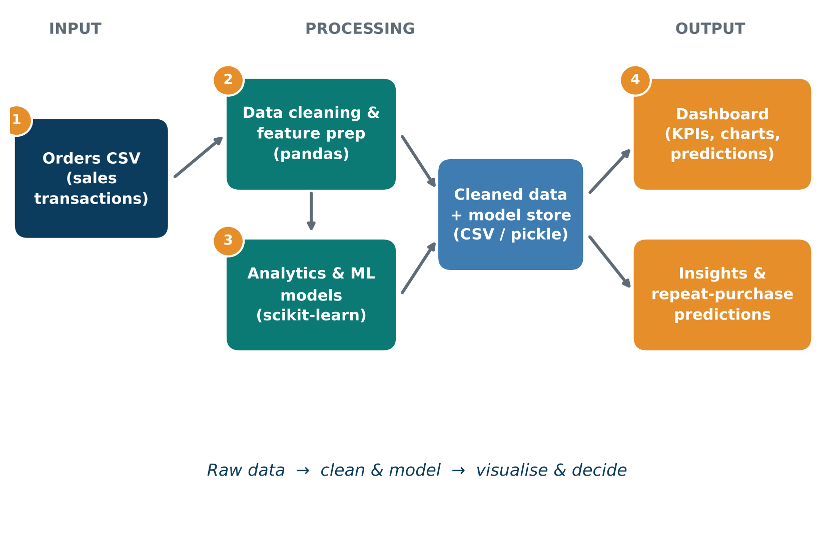
System Architecture
Components
1
Data Source
Order CSV with sales transactions
2
Preprocessing
Cleans, imputes and encodes data
3
Analytics & ML
Computes KPIs; predicts repeat buyers
4
Dashboard
Shows KPIs, charts and predictions
Notes:
Insert a clear block diagram: input, processing, storage, output. Number each block and explain them on the right. Redraw the figure yourself rather than copying it.

Slide 7


Hardware & Software Requirements
Hardware
Software & Tools
Libraries / Frameworks
Intel Core i5 or equivalent
8 GB RAM
1 GB free disk space
No GPU required
Windows 11 / Ubuntu 24.04
Python 3.12
Jupyter Notebook / VS Code
Git and GitHub
pandas 3.0, NumPy 2.5
scikit-learn 1.9
Matplotlib 3.11, Seaborn 0.13
CSV file storage
Deployment / Platform: Local machine with Jupyter Notebook; dashboard views built with Matplotlib and Seaborn
Notes:
List only what you actually used, with versions. For a pure software project, shorten the hardware list and add cloud or deployment resources.

Slide 8
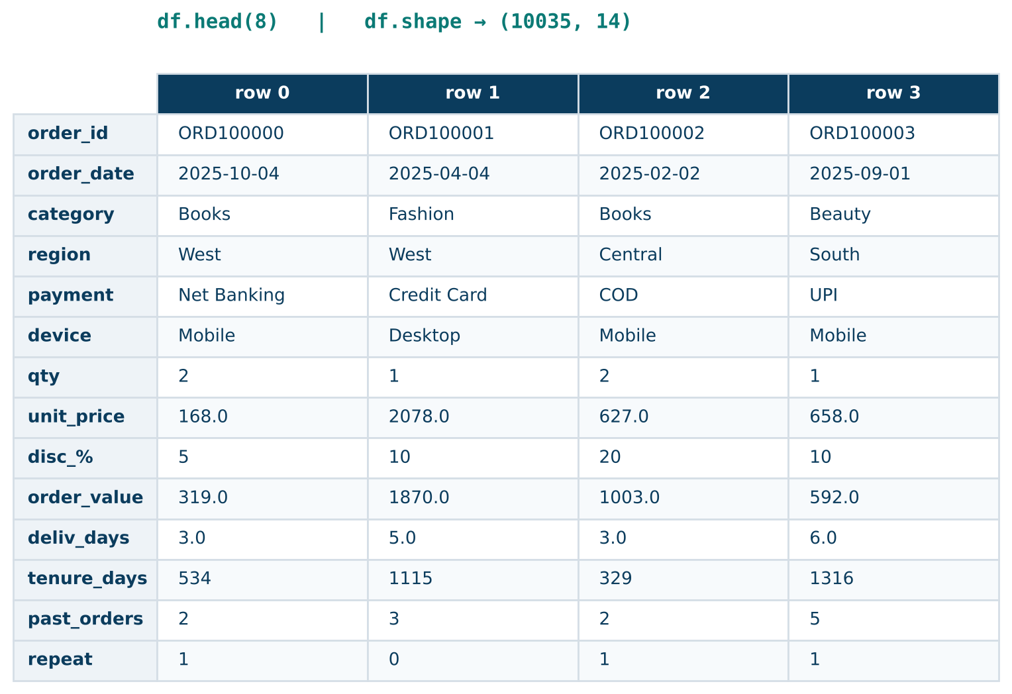
Dataset / Data Understanding
10,035
14
Records (rows)
Features (columns)
212
2
Missing values
Target classes
Source: Synthetic 2025 order data generated in Python (retail schema)
Features: category, region, payment, device, price, discount; target = repeat_purchase
Quality: 212 missing delivery days, 35 duplicates; 47% repeat vs 53% no repeat
Notes:
Explain where the data came from and what it contains. Show a screenshot of the first rows or the info summary. For non-data projects, replace this slide with “Requirement Analysis” or “Input Specification”.

Slide 9
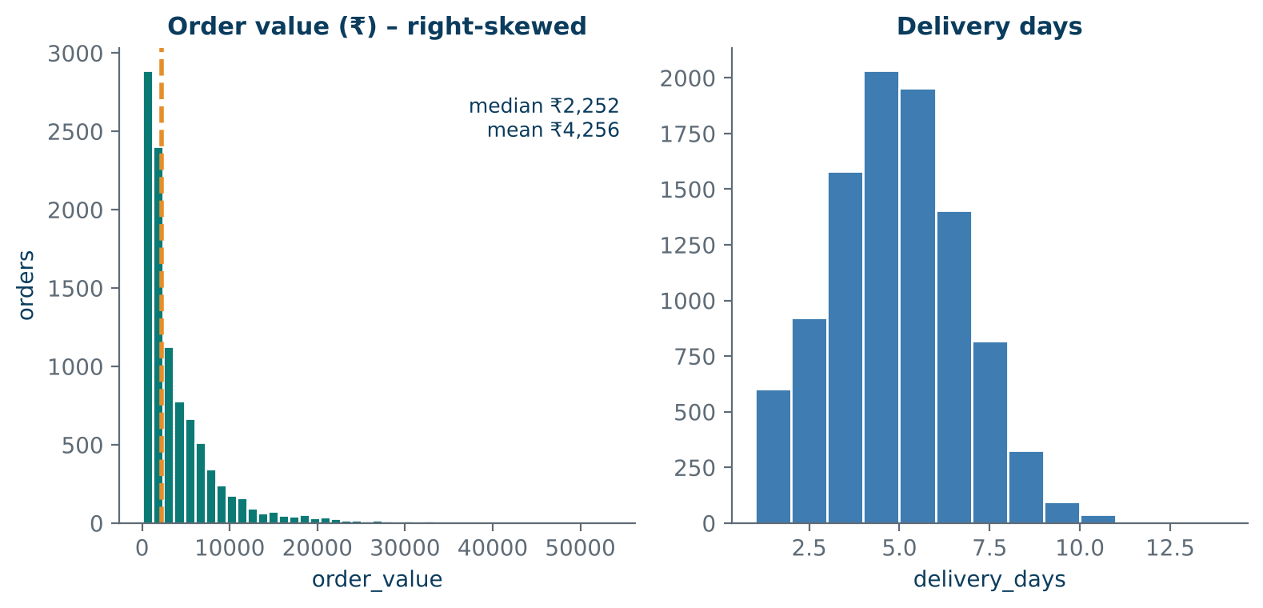
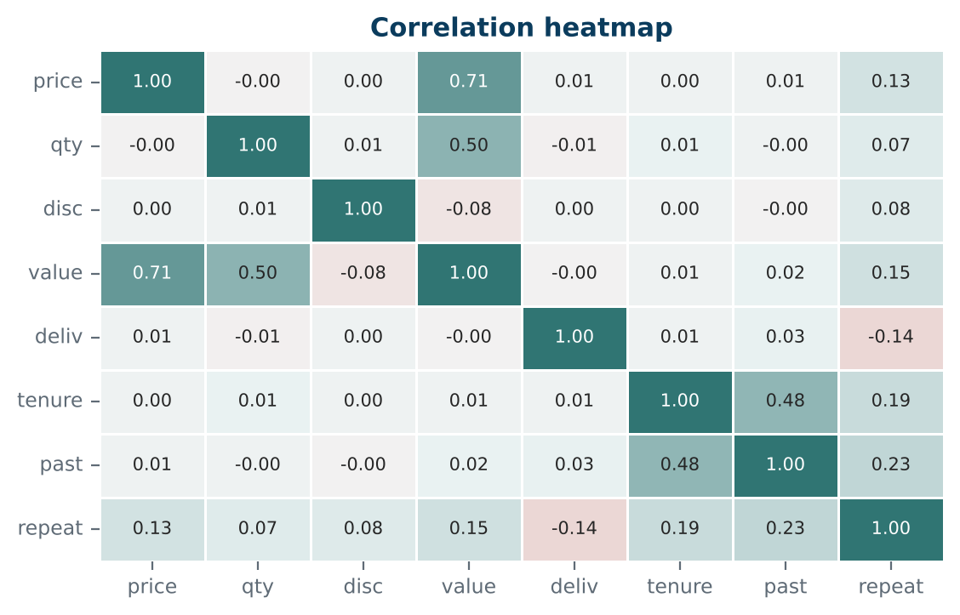



Data Preprocessing & Exploratory Analysis
Cleaning
Transformation
Feature Selection
Dropped 35 duplicates; median-imputed 212 gaps; capped 725 order-value outliers (IQR rule).
One-hot encoded 4 categorical fields; standard-scaled 8 numeric features.
Correlation check and permutation importance; all 12 inputs kept.
Notes:
Show two or three plots that tell a story: distributions, correlations, outliers. Explain what each plot told you and what you did about it.

Slide 10
Module-wise Description
1
Data Ingestion & Cleaning
2
EDA & Sales KPIs
Purpose: Load orders and fix data quality issues
Input → Output: Raw CSV → clean dataset
Developed by: Milan Jain
Purpose: Compute revenue, AOV and trend metrics
Input → Output: Clean data → KPI tables, plots
Developed by: T Varun
3
Predictive Modelling
4
Dashboard & Reporting
Purpose: Train and compare 3 classifiers
Input → Output: Clean features → repeat-purchase score
Developed by: Nikhil Reddy
Purpose: Present KPIs and model insights
Input → Output: KPI tables, scores → dashboard views
Developed by: Milan Jain, T Varun
Notes:
Divide the project into three to five modules. For each, state its purpose, inputs, outputs and who built it. Duplicate a card if you have more modules.

Slide 11

Algorithms & Technologies Used
Logistic Regression
Random Forest
Gradient Boosting
Why chosen
Fast, interpretable baseline for yes/no outcomes
Key parameters
max_iter = 1000; scaled inputs
Why chosen
Captures non-linear patterns; resists overfitting
Key parameters
200 trees; max_depth = 10
Why chosen
Builds shallow trees step by step for complex patterns
Key parameters
150 trees; lr = 0.1; depth = 3
Selection criteria: highest ROC-AUC on the test set, checked with 5-fold CV F1 and model simplicity
Notes:
Name each model, algorithm or technology, say why you chose it, and list the key settings. Then explain how you picked the final one.

Slide 12
Implementation / Model Building
Feature Selection
Code snippet / pseudocode
12 inputs (8 numeric, 4 categorical); target = repeat_purchase
# Key code: stratified split + pipeline
X_train, X_test, y_train, y_test = \
train_test_split(X, y, test_size=0.2,
stratify=y, random_state=42)
pipeline = Pipeline([
("preprocess", preprocessor),
("model", LogisticRegression(max_iter=1000))
])
pipeline.fit(X_train, y_train)
Preprocessing Pipeline
Median imputation, scaling and one-hot encoding
Data Splitting
80/20 stratified split: 8,000 train, 2,000 test
Configuration
Balanced classes (47% repeat); random_state = 42
Notes:
Describe the build in the order you did it. Paste only the most important code or pseudocode, not entire files. For hardware projects, show the circuit or wiring summary instead.

Slide 13
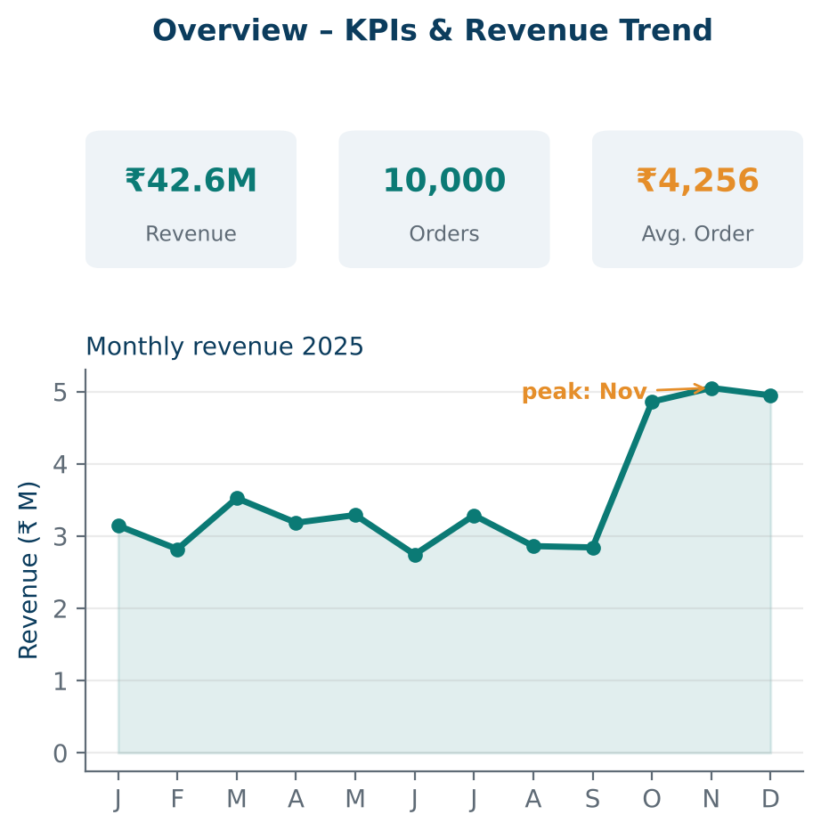
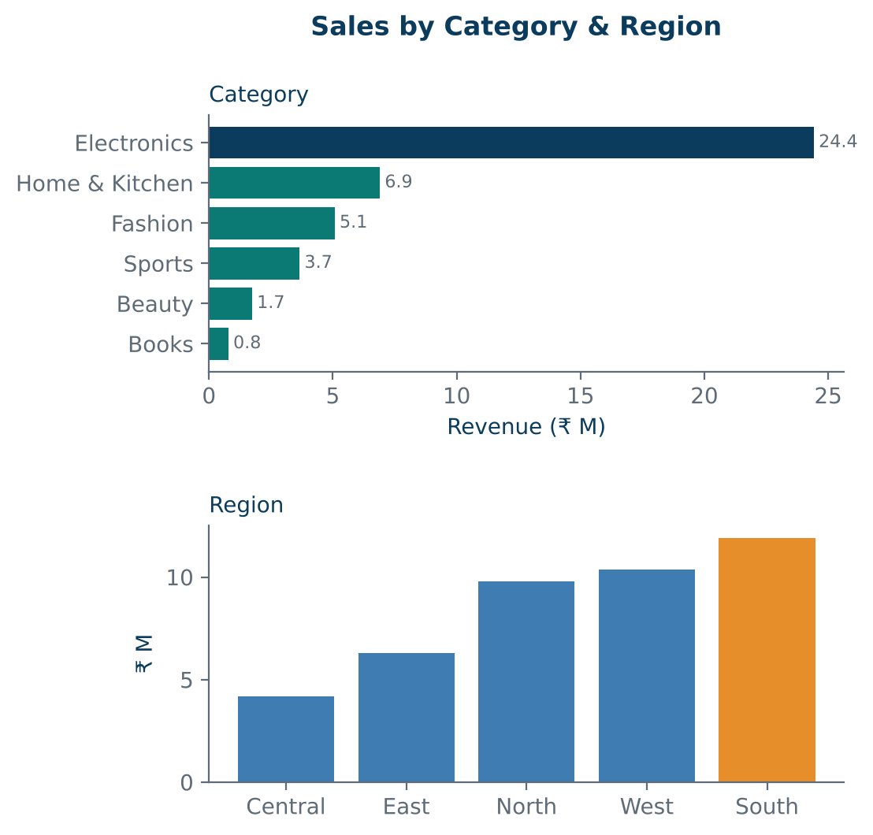
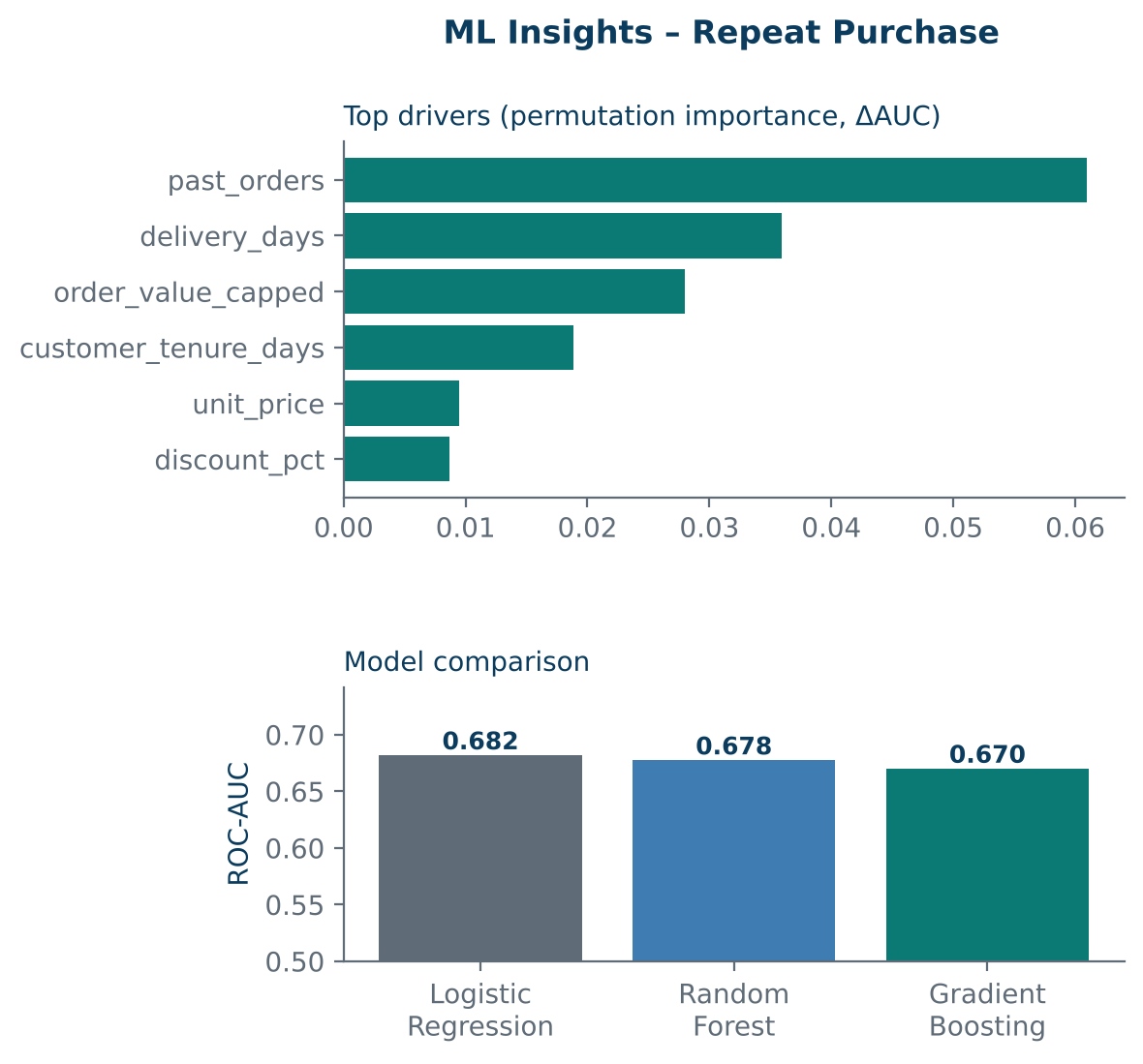
Working Prototype / Output Screens
Overview
Revenue, orders, average order value and monthly trend with a Q4 peak.
Category & Region
Electronics earns 57% of revenue; South is the top region.
ML Insights
Top repeat-purchase drivers and model comparison (ROC-AUC).
Notes:
Show real screenshots, photos of the hardware or a short demo video link. Caption each one with what the viewer should notice.

Slide 14
Results & Performance Comparison
Metric | Logistic Reg. | Random Forest | Grad. Boosting
Accuracy | 0.626 | 0.622 | 0.622
Precision | 0.614 | 0.620 | 0.614
Recall | 0.557 | 0.514 | 0.533
F1-score | 0.584 | 0.562 | 0.571
ROC-AUC | 0.682 | 0.678 | 0.670
Best: Logistic Regression – AUC = 0.682
Hold-out test set of 2,000 orders. 5-fold CV F1 (train): LR 0.602, RF 0.578, GB 0.584.
Notes:
Right-click the chart and choose Edit Data to enter your real numbers. Replace the metrics with the ones that fit your project (accuracy, latency, power, throughput, user rating). State clearly which option performed best.

Slide 15
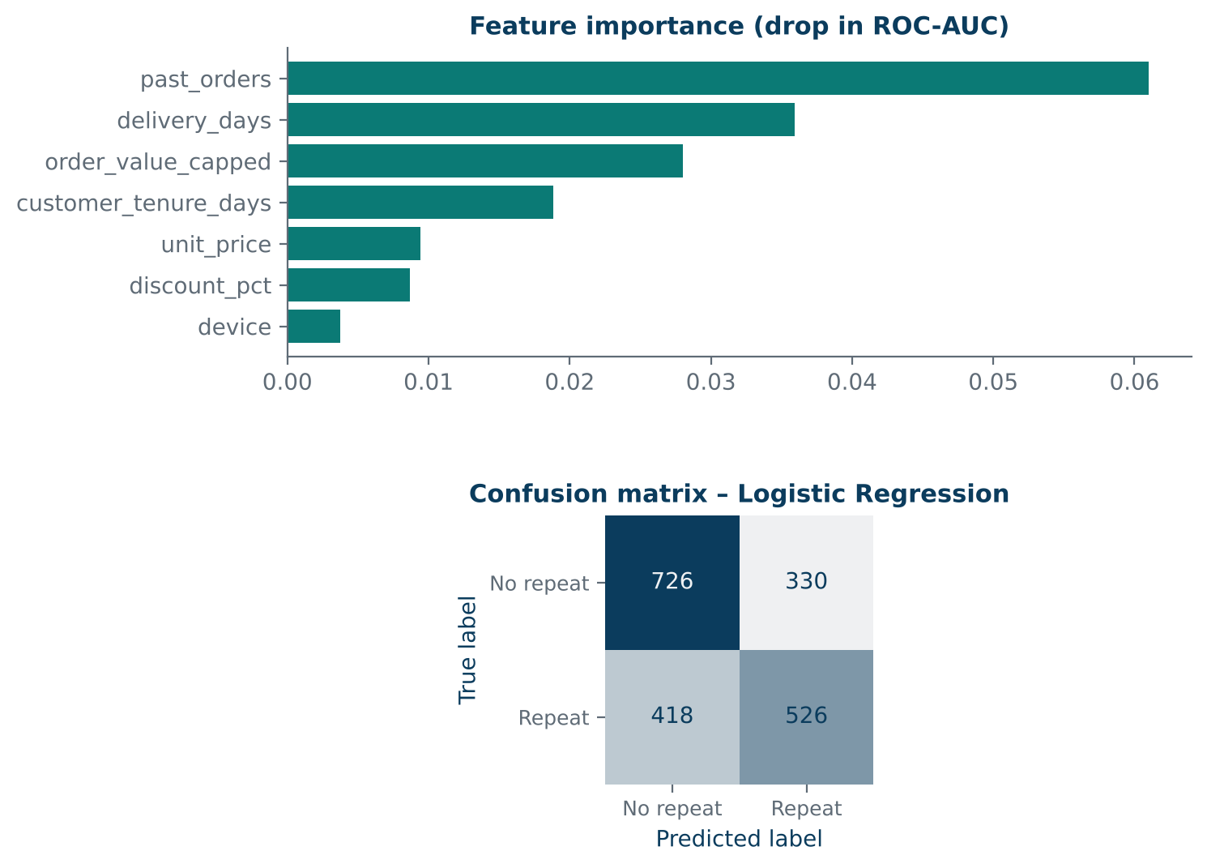
Analysis & Key Findings
62.6%
Best accuracy, achieved by Logistic Regression (ROC-AUC 0.682)
Interpretation: Loyal customers with fast delivery are likelier to return. The model beats chance (AUC 0.5) but is only moderate.
Error analysis: Recall is 55.7%: 418 of 944 repeat buyers are missed, as browsing and review data are absent.
Key drivers: Past orders, delivery days, order value and customer tenure.
Notes:
Explain what the numbers mean. Use a confusion matrix, ROC curve, feature-importance chart or output comparison. Be honest about weak results; panels value that.

Slide 16

Testing & Validation
Test ID | Test Description | Expected Result | Actual Result | Status
TC-01 | Load CSV and check fields | 10,035 rows, 14 columns | 10,035 rows, 14 columns | Pass
TC-02 | Remove duplicate orders | 35 duplicates dropped | 10,000 rows remain | Pass
TC-03 | Impute missing delivery days | No NaN reaches the model | 212 values filled (median) | Pass
TC-04 | Model ROC-AUC on test set | AUC above 0.65 | AUC = 0.682 | Pass
Functional Testing
Validation Method
Performance Testing
Checked data loading, cleaning steps and KPI totals.
5-fold stratified CV plus a 20% hold-out test set.
Compared accuracy, precision, recall, F1 and ROC-AUC.
Notes:
List representative test cases with expected and actual outcomes. Name the validation methods you used. Delete rows you do not need.

Slide 17


Challenges & Limitations
Challenges Faced
Limitations
Messy raw data → fixed with imputation and de-duplication
Skewed order values → outliers capped with the IQR rule
Moderate accuracy → compared three models using CV
Data is synthetic, so results show the method, not real market behaviour
No browsing or review data, so recall stays moderate (55.7%)
Batch analysis only; no real-time data feed
Notes:
Be candid. Pair every challenge with how you solved it, and list limitations that the panel would otherwise spot themselves.

Slide 18

Conclusion
Built an end-to-end sales analytics workflow on 10,000 e-commerce orders using Python and scikit-learn.
1
Final Outcome
Logistic Regression gave the best ROC-AUC (0.682) and accuracy (62.6%), ahead of Random Forest and Gradient Boosting.
62.6%
2
Test accuracy (ROC-AUC 0.682)
Objectives achieved: 4 of 4
All four objectives were met: clean data, KPI analysis, model comparison and a KPI dashboard.
3
Notes:
Revisit each objective and say whether you met it. Quote your headline result with numbers. Do not introduce new material here.

Slide 19



Future Scope & Applications
Improve Performance
Grid-search tuning; try XGBoost
Applications
Retail sales and inventory planning
Targeted offers and loyalty campaigns
Seasonal demand forecasting
Adopters: online retailers and D2C brands
Expand Data / Features
Add browsing, review and returns data
Deploy & Build an Interface
Interactive Streamlit or Power BI dashboard
Scale & Secure
Cloud deployment with protected customer data
Notes:
Give concrete next steps, ideally tied to the limitations. Then name two or three real-world uses.

Slide 20
Team Contribution
Reg. No. | Name | Contribution / Modules Handled
2420030789 | Milan Jain | Module 1 (cleaning), Module 4 (dashboard); dataset preparation; report
2420030768 | Nikhil Reddy | Module 3 (ML models); testing and validation; results analysis
2420030039 | T Varun | Module 2 (EDA and KPIs), Module 4 (visuals); documentation
Notes:
Show that work was planned and shared. Every member should be able to explain their own module.

Slide 21

References
[1] L. Breiman, “Random forests,” Machine Learning, vol. 45, no. 1, pp. 5–32, 2001.
[2] T. Chen and C. Guestrin, “XGBoost: A scalable tree boosting system,” in Proc. 22nd ACM SIGKDD Int. Conf. Knowledge Discovery and Data Mining, 2016, pp. 785–794.
[3] D. Chen, S. L. Sain, and K. Guo, “Data mining for the online retail industry: A case study of RFM model-based customer segmentation using data mining,” J. Database Marketing & Customer Strategy Management, vol. 19, no. 3, pp. 197–208, 2012.
[4] S. J. Taylor and B. Letham, “Forecasting at scale,” The American Statistician, vol. 72, no. 1, pp. 37–45, 2018.
[5] F. Pedregosa et al., “Scikit-learn: Machine learning in Python,” J. Machine Learning Research, vol. 12, pp. 2825–2830, 2011.
Project Links
GitHub: [add repository URL]
Dataset: ecommerce_orders_clean.csv (project file)
Demo video: [add demo link]
Notes:
Use IEEE style, numbered in order of first citation in the deck. Include datasets, documentation and code repositories.

Slide 22
THANK YOU
Questions & Discussion
Team: Milan Jain | Nikhil Reddy | T Varun
Guide: Dr.N.Sunanda, Associate Professor, Department of CSE, KLH University
Notes:
Leave this slide up during questions. Make sure every team member can answer questions about their own module.

